Slide 1




AI For Network Security
CS 433 Computer Networks, IIT Gandhinagar
Aaryan Darad
Abhay Kumar Upparwal
Aman Singh
Disha Chopra

Slide 2

INTRODUCTION
Network Security is crucial in the tech era, demanding advanced solutions.
AI detects and identifies network threats, bolstering proactive defense.
Using AI and ML algorithms, we can recognize common attack features, enhancing preventive measures for future security threats.

Slide 3
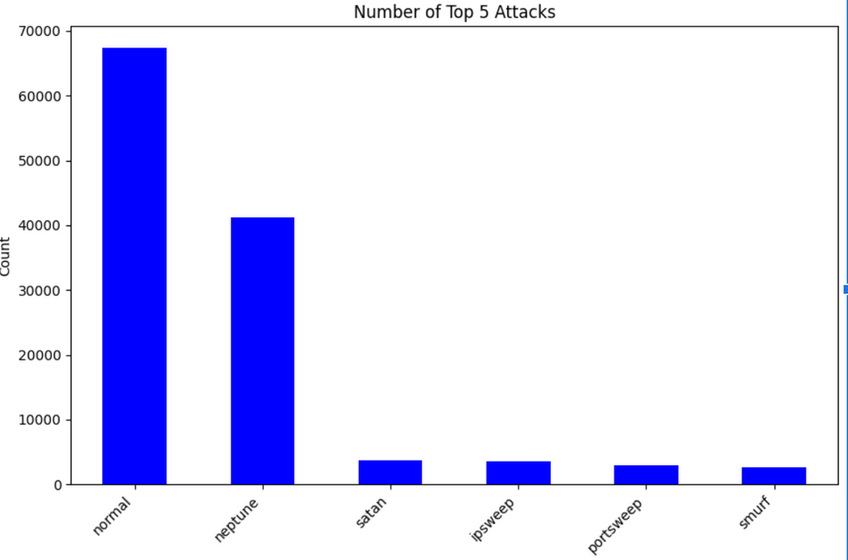
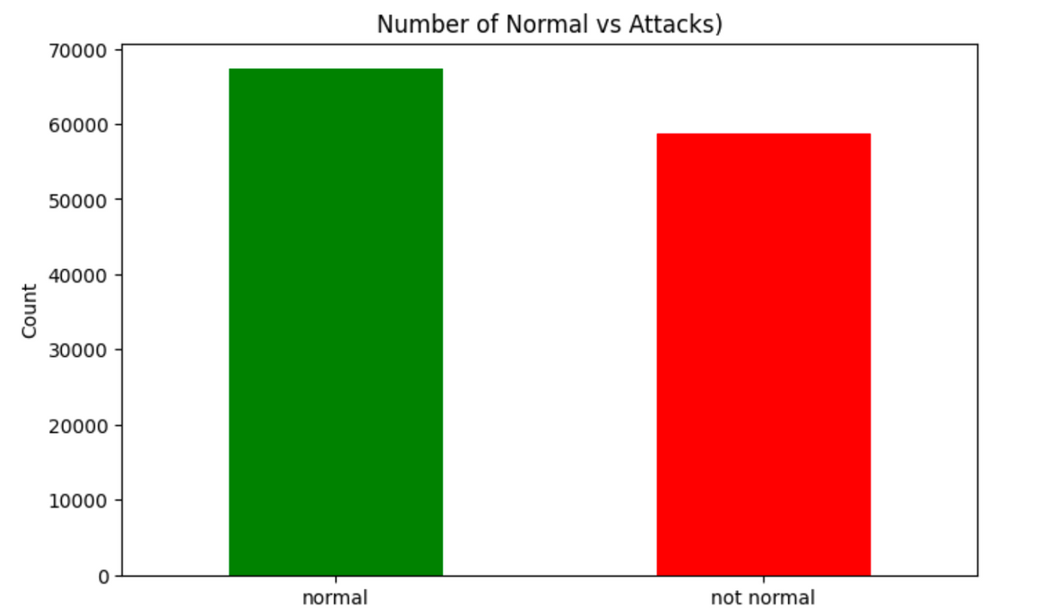
NSL-KDD Dataset
The dataset includes 125,973 stream records and covers 22 types of attacks, including DoS attacks, Probe Attacks, and PortScans. The dataset is large enough to provide accurate results but not too large to be unprocessable.

Slide 4
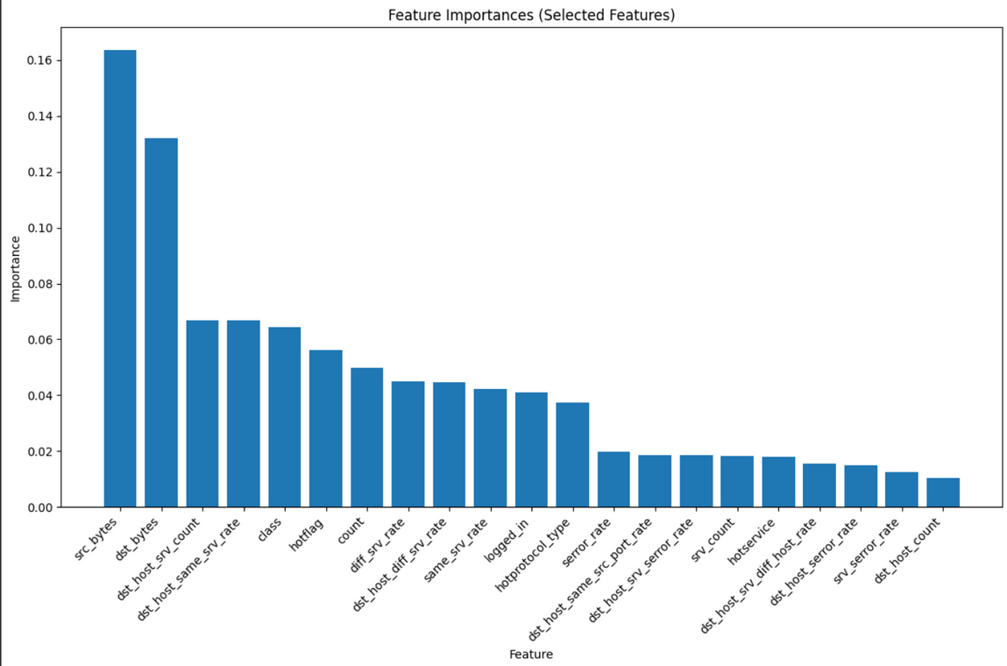
Important Features for Anomaly Detection
Important features for anomaly detection were identified using
feature weights from Random Forest Mechanism
Some important features:
Source Bytes
Destination Bytes
Number of connections
Error rate of server connections

Slide 5
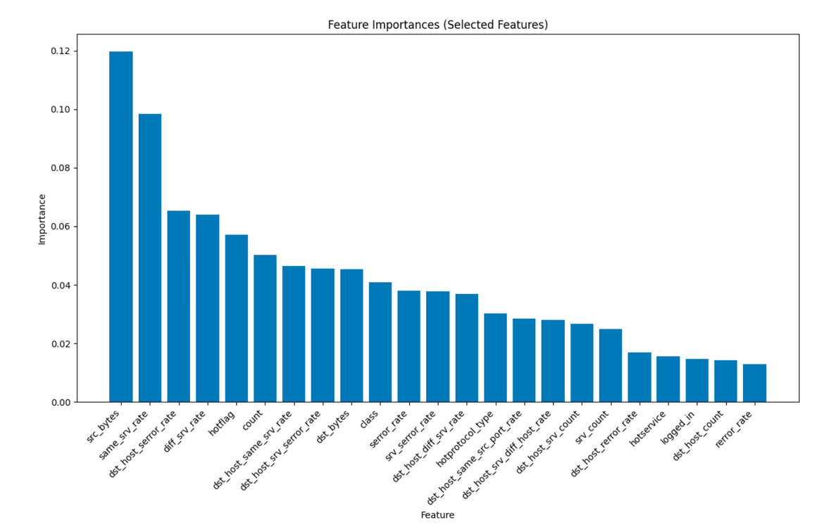
Important Features: Binary vs Multi-Class

Slide 6
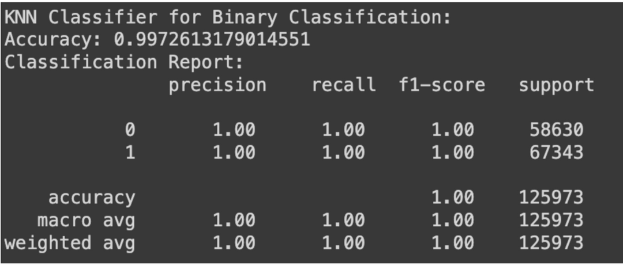
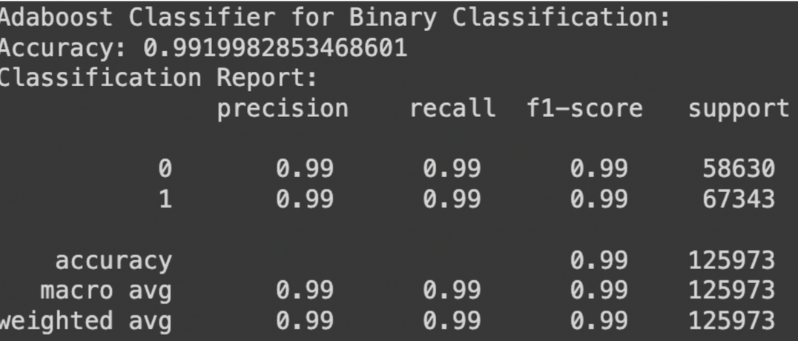
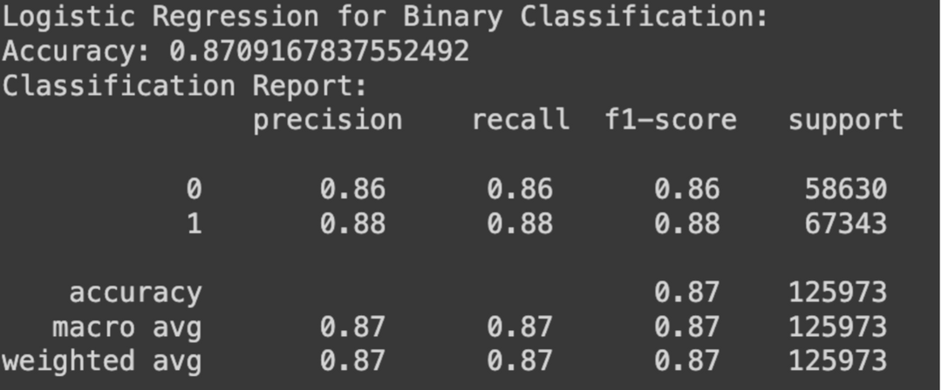
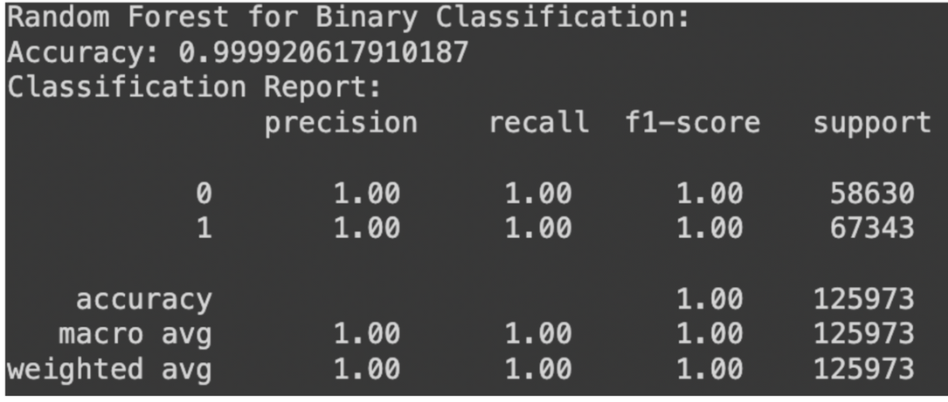
Machine learning algorithms for binary Classification

Slide 7
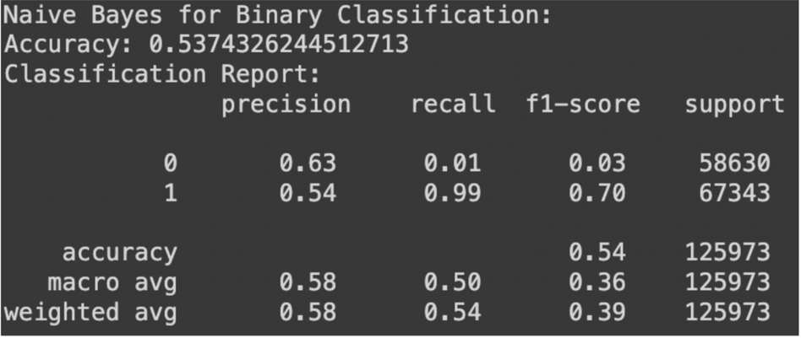
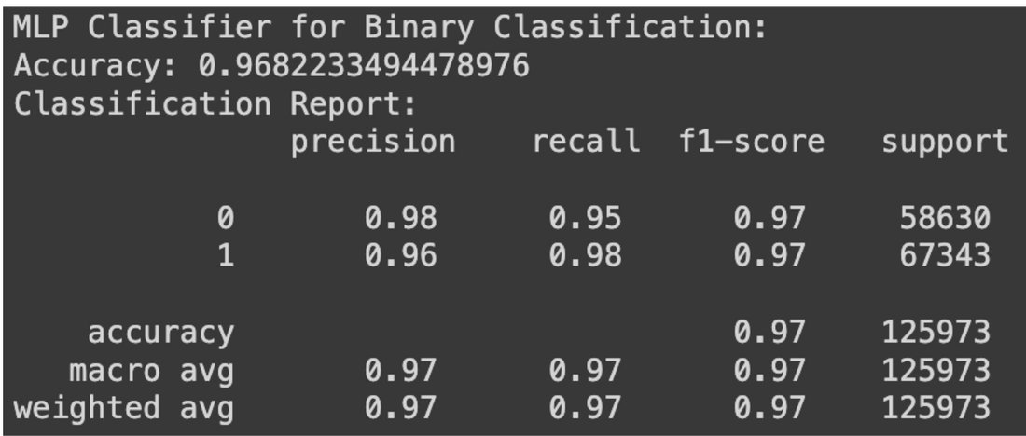
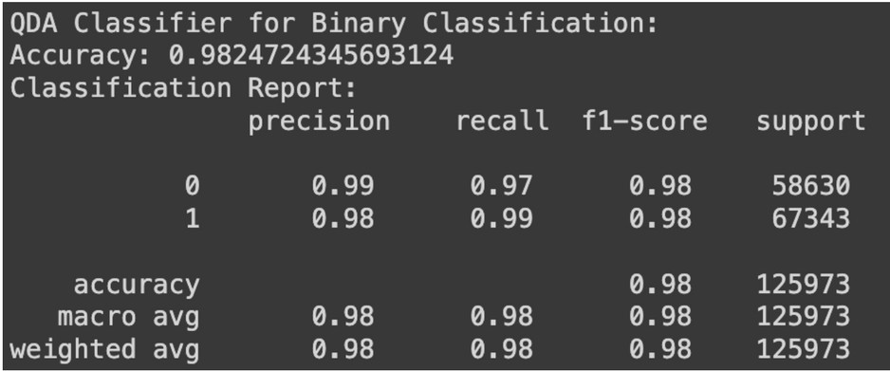

Slide 8
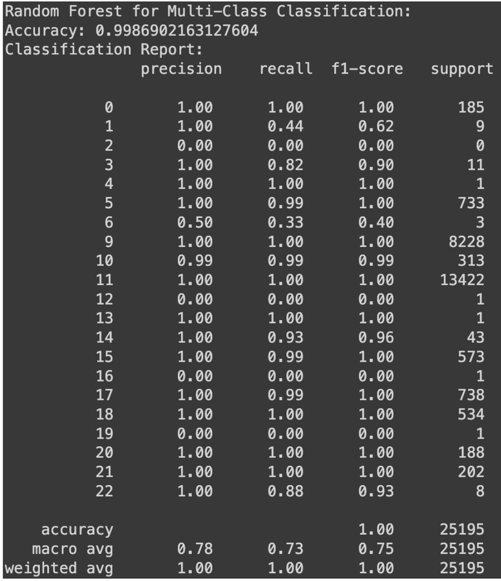
Random Forest Algorithm for multiclass classification

Slide 9
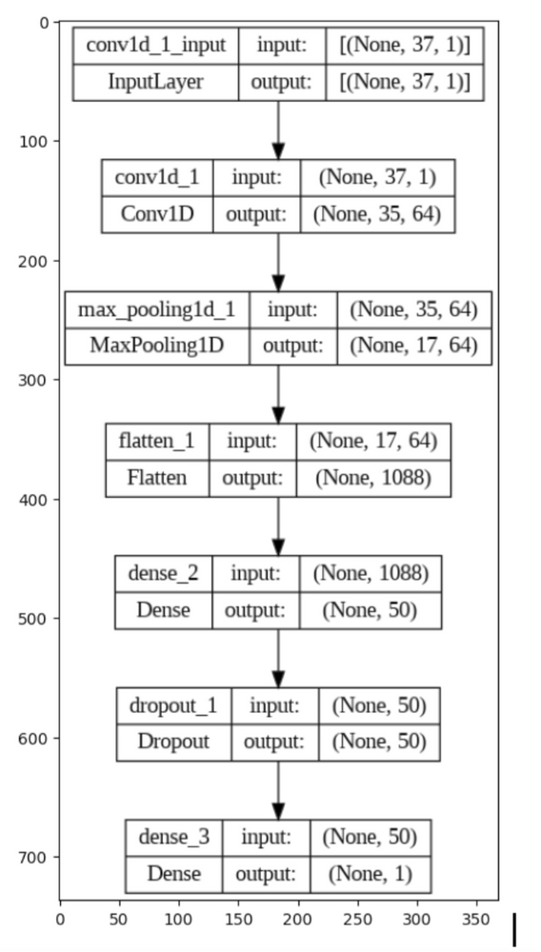
1 Dimensional Convolutional Neural Network
Neural Network Layers
Conv1d: 64 filters, kernel size 3, stride 1, padding 1
MaxPooling1d: pool size 2
Flatten
Dense: 50 neurons, ReLU activation
Dropout: 0.2 dropout rate
Dense: 1 neuron, sigmoid activation

Slide 10
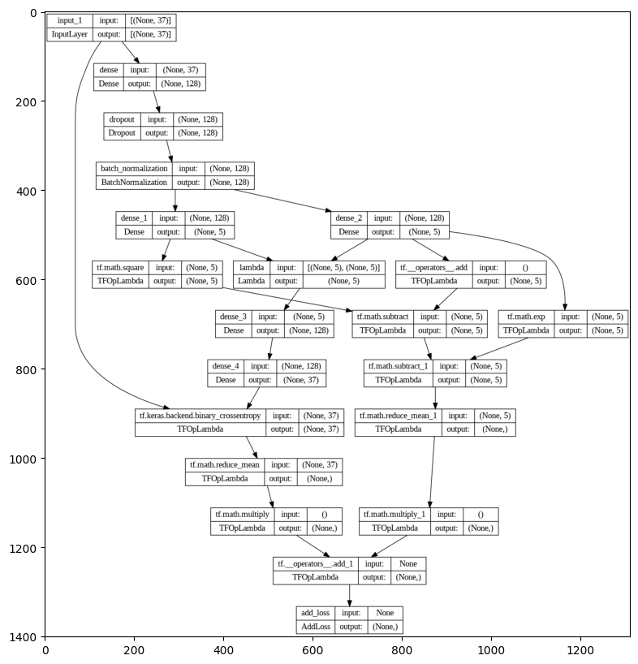
Variational Autoencoder
Encoder:
Dense layer 1: 128 neurons, ReLU activation
Dropout layer: 0.2 dropout rate
Batch normalization layer
Dense layer 2: 5 neurons, ReLU activation
Lambda layer 1: Splits output into mean and variance vectors
Square layer: Squares variance vector elements
Lambda layer: Combines mean and variance vectors into latent distribution
Decoder:
Lambda layer 2: Samples from latent distribution
Dense layer 3: 128 neurons, ReLU activation
Dense layer 4: 37 neurons, sigmoid activation
Lambda layer 3: Reconstructs input data from latent representation

Slide 11
Comparing all methods and their accuracy
Methods | Accuracy
Random Forest | 99.99%
Naive Bayes | 53.74%
Logistic Regression | 87.09%
AdaBoost | 99.19%
KNN | 99.72%
MLP | 96.82%
QDA | 98.24%
1D CNN | 98%
Variable AutoEncoder | 91%
Random forest and AdaBoost algorithm has the best accuracy among all the methods used in our project

Slide 12
Learnings
Data Selection significance
Network feature Importance
ML models
Neural Network models

Slide 13
Thanks

